Slide 1

:-
Report on tools and methods that are used for Reconaissance and describe the uses ,functions and its outcome .
Name – MD SHOHAIL
Batch : CNP_MAR2024-CSEH -1

Slide 2


INDEX
Reconaissance
Importance of Reconaissance
Understanding some tools used for Reconaissance
Network Scanning
Why Network Scanning ?
Tools for Network Scanning
Understanding Networking Scanning Tools with commands
Service Enumeration
Why Service Enumeration ?
Understanding Service Enumeration Types with commands
References

Slide 3
Reconaissance (Information Gathering)
Reconaissance :- It refers to process of gathering information about a target system ,network or organization to identify potential vulnerabilities. This is typically the first phase of ethical hacking where hackers/ethical hackers collect as much as information about a target .
There are two types of Reconaissance :-
Active Reconaissance
Passive Reconaissace
Active Reconaissance :- It is the process where the hackers/ethical hackers interacts with the target system to gather information.
Some of the tools used for active reconaissance are Nmap, Ping, Netcat,Hping3 , etc.
Passive Reconaissance :- It is the process where the hackers/ethical hackers gathers information without directly interaction with the target system.
Some of the tools used for passive reconaissance are whois, mxtoolbox, subdomainfinder ,dnsinfo, nslookup, etc.

Slide 4


Importance of Reconaissance
Here are some keys why reconaissance is important :-
For Attackers :
1.Identifying targets – Reconaissance helps attackers identify potential targets by gathering information about system,networks and personal.
2. Discovering vulnerabilities – By collecting information on software configurations and network structures ,attackers can pinpoint vulnerabilities to exploit .
3. Planning Attacks – Detailed information gathered during reconaissance allows attackers to design more effective and targeted attacks.
4. Avoiding detection – Understanding the targets security and measures and monitoring capabilities helps attackers avoid detection and develop stealthier attack methods.
For Defenders :
Threat Intelligence – Reconaissance helps defenders gather intelligence on potential threats ,including information about known attack vectors and malicious actors.
2. Vulnerability Assesment – By performing regular reconaissance on their own system ,defenders can identify and remediate vulnerabilities before attackers exploits them.
3.Incident Response – Effective reconaissance allows defenders to quickly gather information during a security incident,enabling faster and more effective response and mitigation.
4.Improving Security Posture – Ongoing reconaissance helps organizations understand their security landscape,leading to better risk management and ,ore informed security decisions.

Slide 5
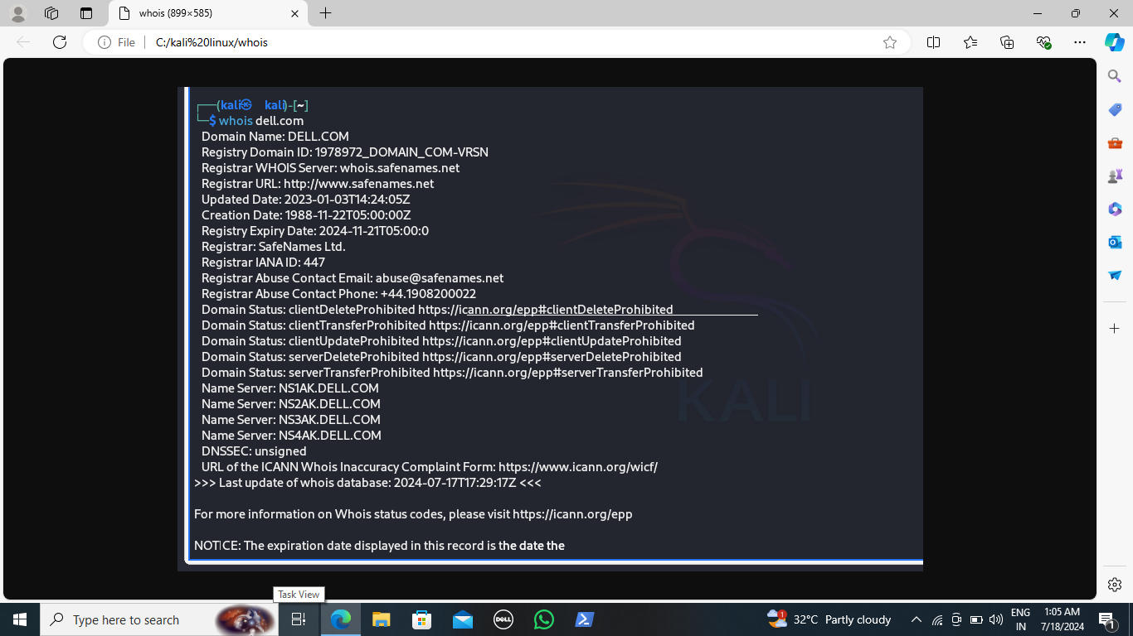
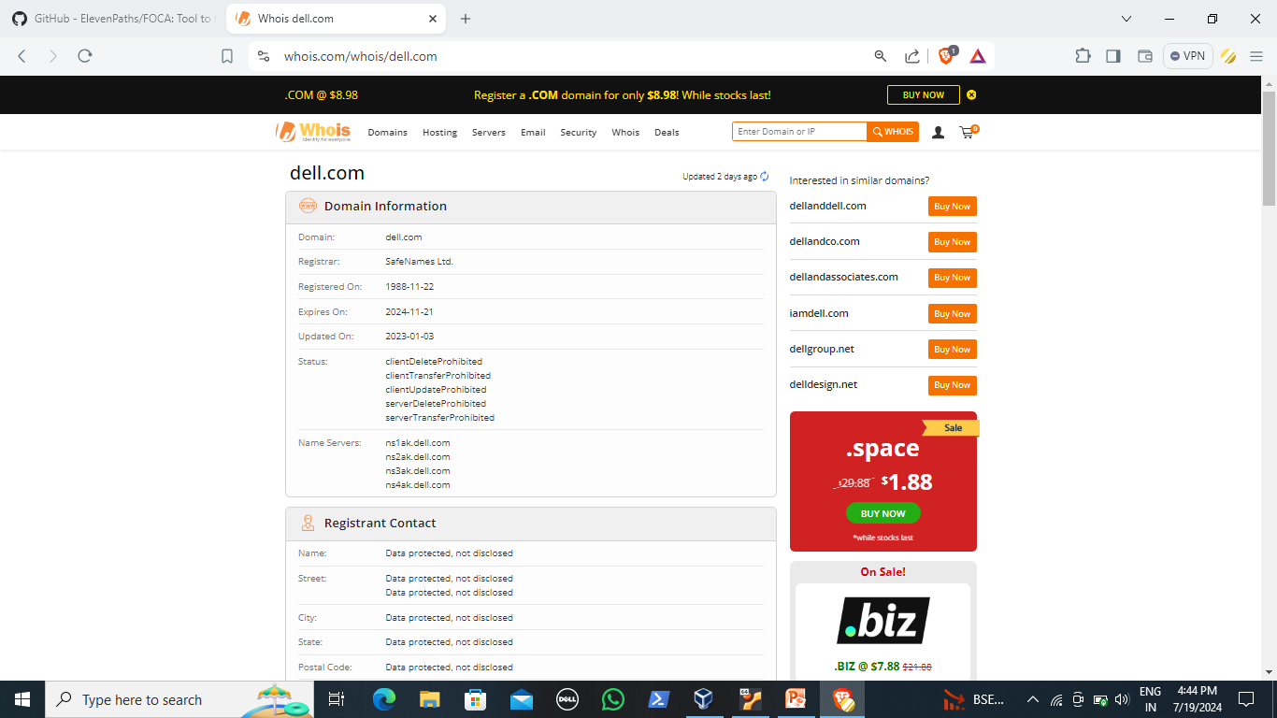
Understanding reconaissance tools with commands
Tool no. 1
Whois :- Whois command is a powerful tool that allows you to retrieve essential information about a domain or an ip address and network devices registered with internet corporation for assigned names and numbers.
How to use:-
1. Search in browser “whois.com”
Search for domain or ip address in whois.com
Eg; whois dell.com
2. In Linux terminal enter the command “ whois” domain name
or ip address

Slide 6
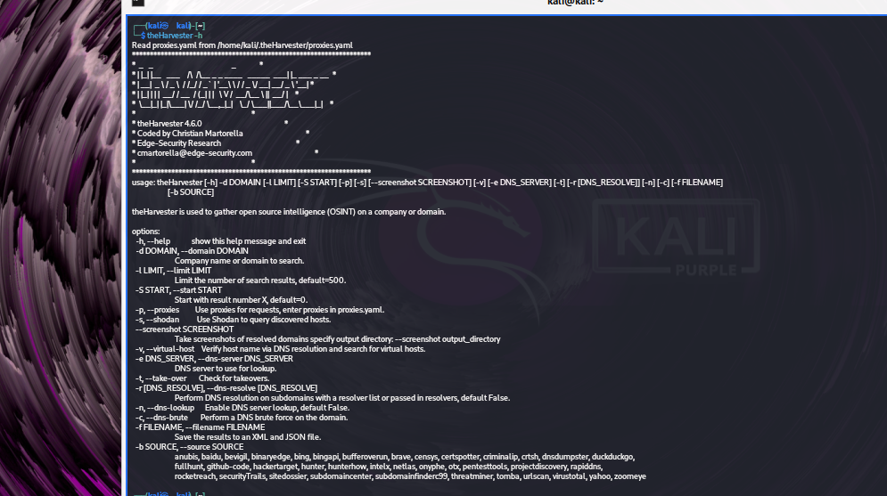
Tool no. 2
Understanding theHarvester:
- It is an OSINT tools used for gathering information about a domain name .
It is used to find e-mails ,IP address, sudomains and urls using multiple resources.
Installation:-
“sudo apt install theHarvester”
How to use :-
In kali linux terminal use the command
theHarvester –d(domain) –b (source)
Use theHarvester –h for help

Slide 7
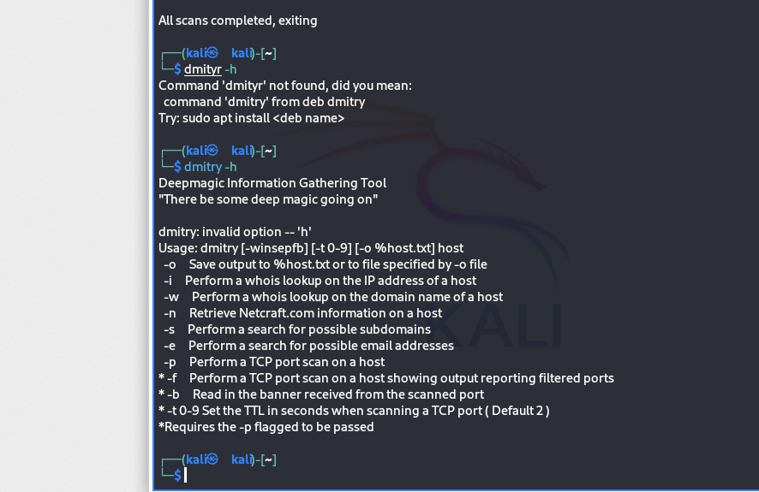
Tool no 3
Understanding Dmitry :
It is a free and open-source tool used for information gathering.
It stand for deep information gathering tool.
It is used to search subdomains of target.
It is used t o gather information such as operating system,
webserver details ,etc.
Installation :- “ sudo apt install dmitry”
How to use : -
In kali linux terminal use the command -dmitry –w domain name
Dmitry –h

Slide 8
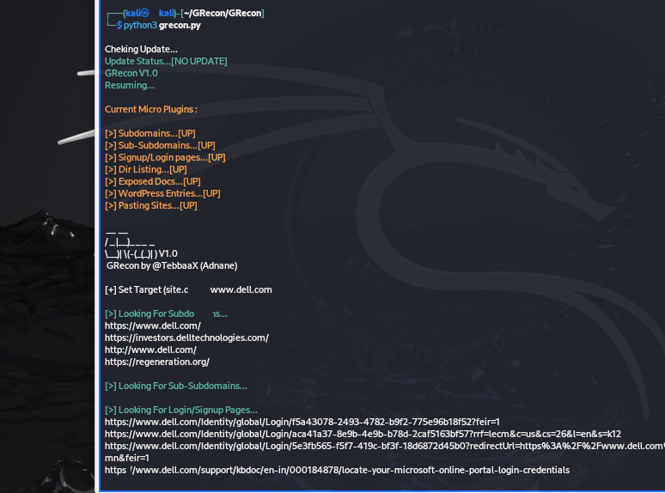
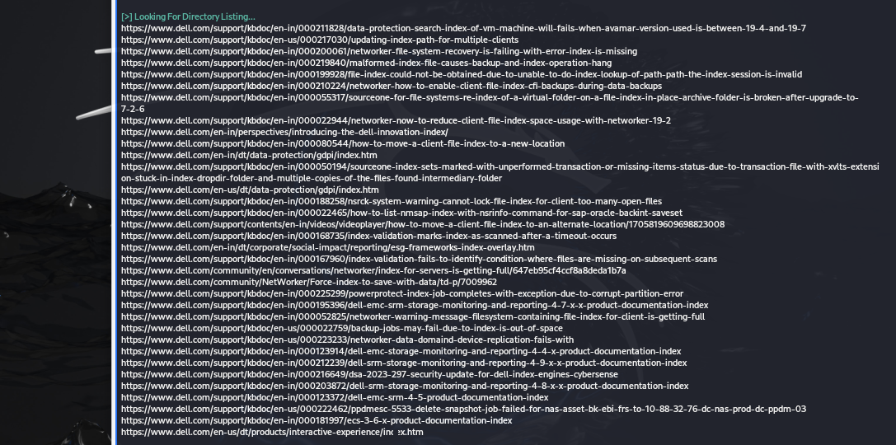
Tool no. 4
Understanding Grecon :
- It is a simple python tool.
- It is used to find :-
Subdomains
Sub-sub domains
Wordpress entries
Directory listings
Installation : In kali terminal run
gitclone http://github.com/TebbaX/GRecom.git
cd Grecon
ls
Python3 –m pip install – r requirements.txt
Python3 Grecon.py
How to use : In kali terminal
Open Grecon
Set target site name

Slide 9
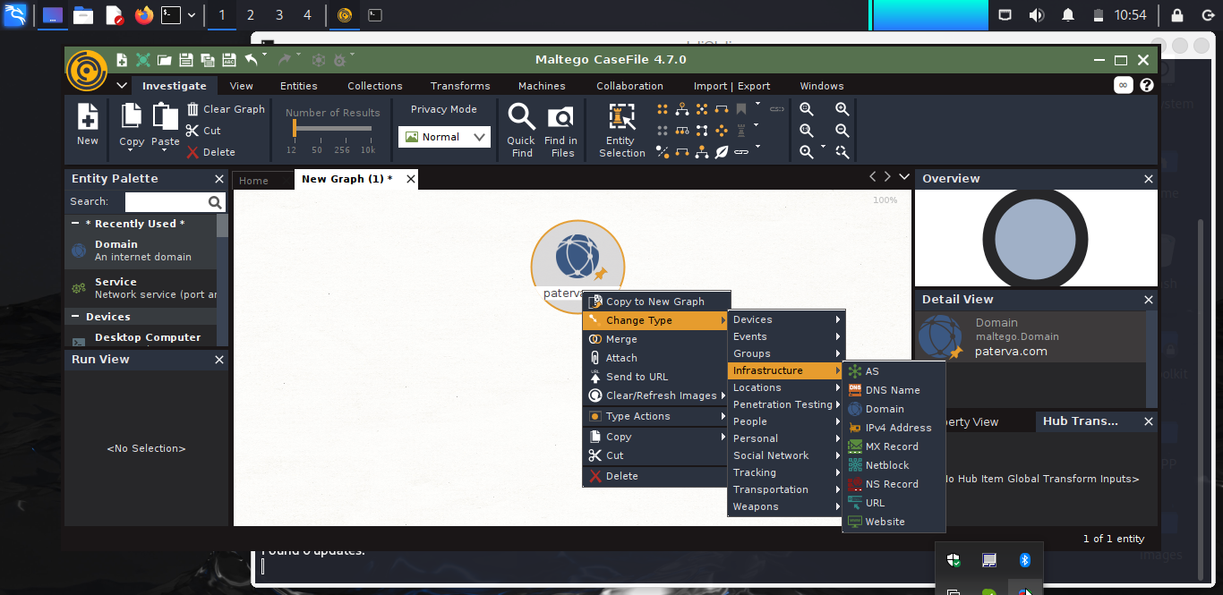
Tool no. 5
Understanding Maltego :
It is an OSINT tool used for information gathering.Some of the data sources through which maltego gather information are Dns records,whoisrecords,search engines,social networking ,etc.
It is a GUI tool.
Installation:-
It is preinstalled in kali linux.
If not installed in kali linux then you can
Install using command given below
“sudo apt install maltego”
How to use:
In linux terminal type “maltego” it will automatically open or you can also open it from application of kali linux

Slide 10
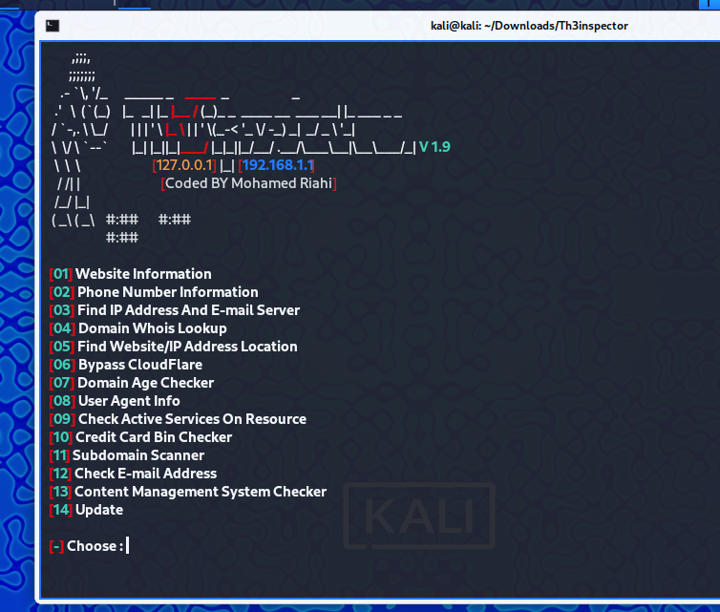
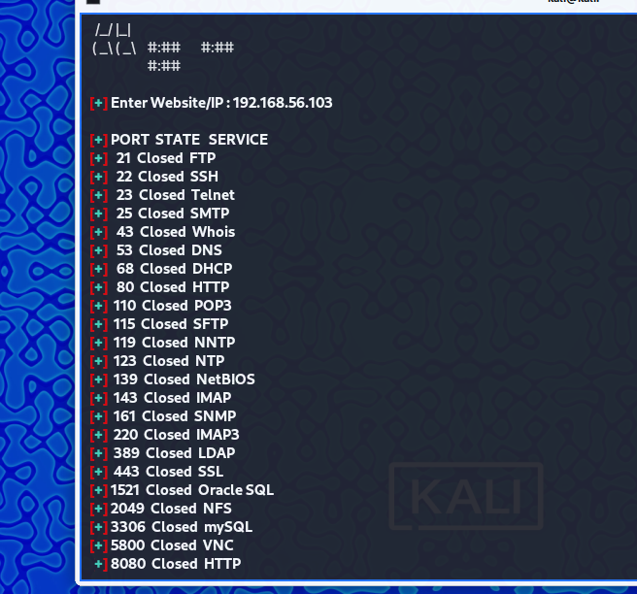
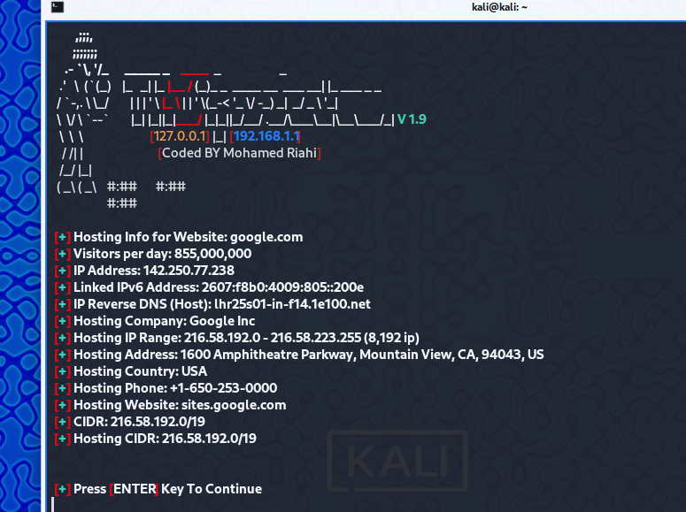
Tool no.6
Understanding Th3inspector :-
It is an OSINT tool used for information gathering .
One can easily find a lot of information about the target, such as details about the server, whois info, target IP, mobile number, email, sub-domains, etc.

Slide 11
Understanding Network Scanning:
It is the process of identifying active hosts, ports and services used by target applications or system.
It is the second step after Reconaissance.
Different types of network scanning are :
Port Scanning : Identifying open ports on network to determine which services are running and which services are not running.
Host Scanning : Identifying active hosts on network to determine which devices are online and which are not.
Service Scanning : Identifying services running on network to determine which application are installed and which are not.
Network Analyzer : Analyzing network traffic to identify devices ,protocols and services in use.
These scanning techniques are used by ethical hackers in organization to maintain network security and to identify vulnerabilities in a system .However they can also be used by malicious hackers to compromise a network.
Some of the Network Scanning tools are :
Nmap
Hping3
Wireshark
Masscan
Angry Ipscanner
Netcat
TCPdump
Advanced Ipscanner

Slide 12
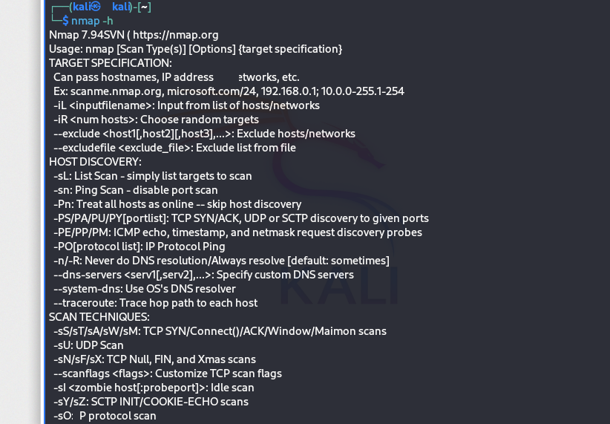
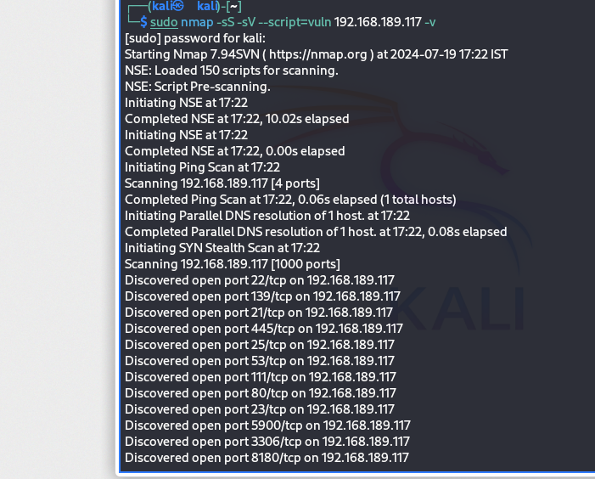
Understanding Network Scanning tools with commands
Tool no. 1
Understanding Nmap :-
Nmap is short for network Mapper.
It is an open-source linux command line tool used to scan IP address and ports in an network.
It allows network admins to find which devices are running on their network ,discover open ports and services and to detect vulnerabilities.
It also find information about operating system running on devices.
It also provides OS versions.
Installation :- It is pre-installed on kali linux
If not installed in kali linux then use the commands to install nmap :–
To download “sudo apt install nmap”
For windows : https://nmap.org/download
Commands to use :- nmap target IP
nmap –sS target IP (Stealth Scan)
nmap – sV target (Service Version)
nmap –p target IP (port Scan)
nmap – sT target IP (TCP scan)
nmap –sU target IP (UDP scan)
nmap –sV –O –script vuln target ( vulnerability scan)
nmap –sS-sV –script=vuln target ip –v( vulnerability scan)
nmap - A target IP (Aggressive Scan)
nmap –sC targetv IP ( Script Scan)
nmap target IP –oN ( Normal output )
nmap target IP –oX (XML output)
nmap target IP –v ( verbosity)
nmap target IP –vv ( greater verbosity)
nmap target IP –packet-trace (show all packets sent and received)
nmap -6 target ipv6 ip addrr.( Enable IPv6 scanning)
nmap target ip –(T1 – T5) speed of scan
There are many more commands in Nmap for different scans.

Slide 13
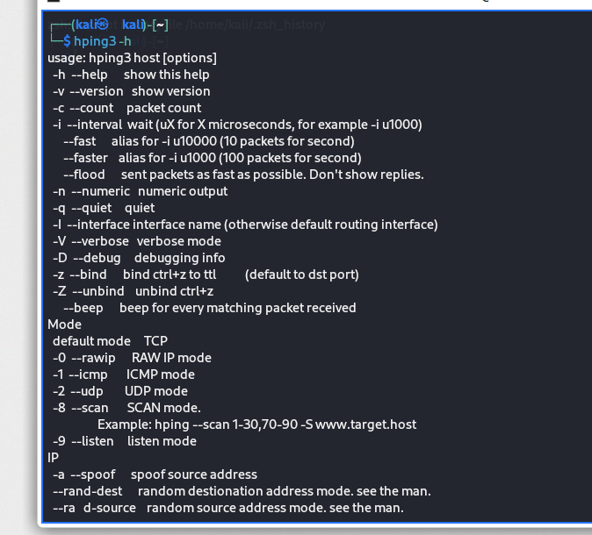
Tool no. 2
Understanding Hping3 :-
Hping3 is an network tool able to send custom ICMP/UDP/TCP packet to display target replies like ping does with ICMP replies.
It is used for port scanning and to test network performance and also for network scanning.
It is used for DOS attack by flooding a packet in target system.
Installation :- “sudo apt install hping3”
How to use:-
hping3 –h(help)
hping3 –scan 1-1024 IP (Scanning)
hping3 –S (victim IP)-a (attackers IP)—flood-p
(For Dos attack )

Slide 14
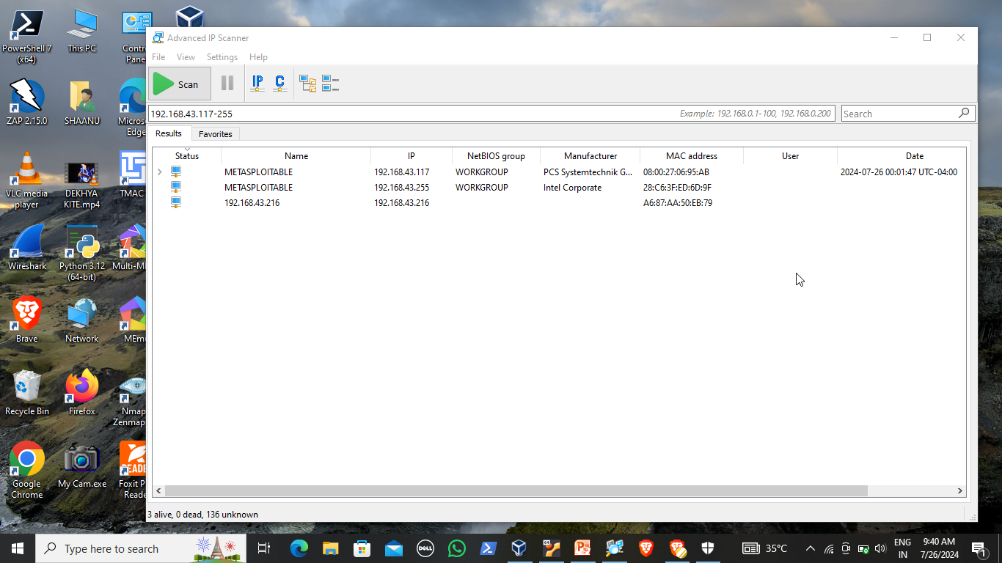
Tool no. 3
Understanding Advanced IP Scanner
It is a reliable and free network scanner to analyze LAN.
The program shows all network devices, gives you access to shared folders, provides remote control of computers (via RDP and Radmin), and can even remotely switch computers off.
It is easy to use and runs as a portable edition.
It should be the first choice for every network admin.
Installation :-
https://www.advanced-ip-scanner.com/
Advanced IP Scanner is not available for Linux but there are plenty of alternatives that runs on Linux with similar functionality. The best Linux alternative is Nmap, which is both free and Open Source. If that doesn't suit you, our users have ranked more than 50 alternatives to Advanced IP Scanner and 16 are available for Linux so hopefully you can find a suitable replacement. Other interesting Linux alternatives to Advanced IP Scanner are Angry IP Scanner, Zenmap, mtr and Vernet

Slide 15
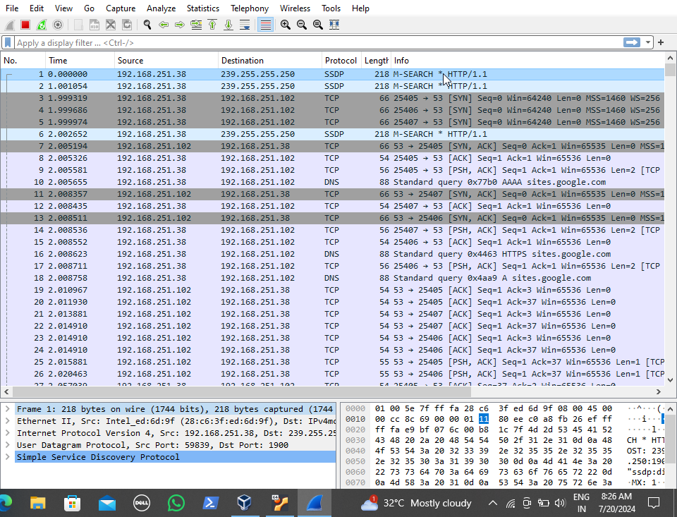
Tool no. 4
Understanding Wireshark:-
Wireshark is a network packet analyzer.
It captures packet data used for network troubleshooting analysis.
It is used by network security engineers to examine security problems.
It captures live packets from network interface.
Displays packet with very detailed protocol information.
It is an open-source tool.
Available for both windows and linux.
Installation :- It is preinstalled in kali linux.If nit installed then use the command to download “sudo apt install wireshark”
How to use :- In kali linux terminal use the command sudo wireshark.Wireshark terminal will open .
In windows download it from www.wireshark.com
Some of the filters used in wireshark to find packets are –
ip.addr==ip address (src or dst)
Ip.addr==src or dst ip &&ip.addr==src or dst ip.(set a conversation betw two ip addr.
Tcp port==4000(set a filter for any TCP packet with 4000as src or dst port
http.request ( for display http request)
Ip.src==ip address
Ip.dest==ip address
Eth.addr==(mac address) for mac address filter

Slide 16
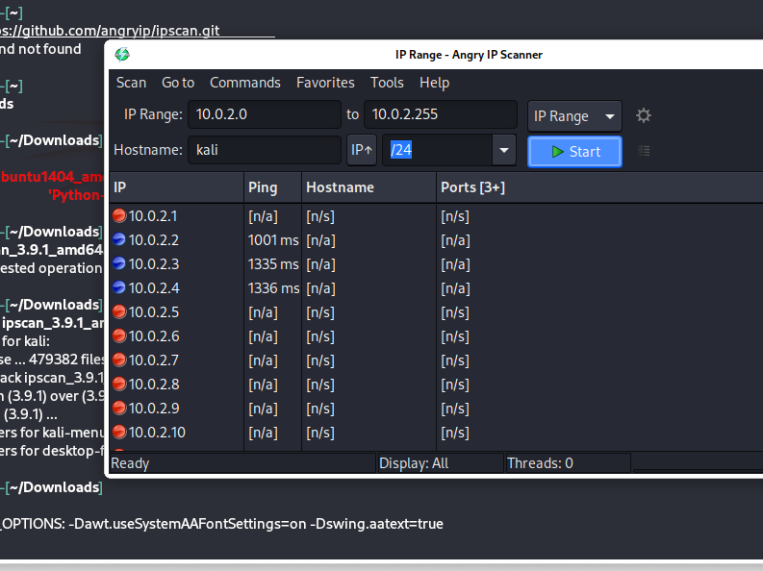
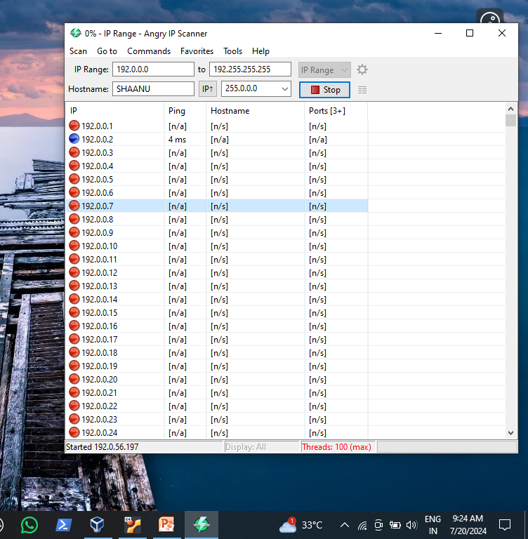
Tool no. 5
Understanding AngryIPscanner
AngryIPscanner is a powerful and versatile tool that can be used for various purposes. Here are some common uses of AngryIPscanner given below :-
Network Scanning
IP address addressing
Port Scanning
Network Troubleshooting
Network Auditing
Network Monitoring
Security Scanning
Installation :- for windows - https://angryip.org/download
for Linux - cd Downloads
gitclone https://github.com/angryip/ipscan.git
ls
dpkg –I ipscan_3.9.1_amd64.deb
ipscan

Slide 17
Understanding Service Enumeration :-
Enumeration is extracting a system’s valid usernames, machine names, share names, directory names, and other information. It is a key component of ethical hacking and penetration testing, as it can provide attackers with a wealth of information that can be used to exploit vulnerabilities. It can also be defined as collecting detailed information about the target systems, such as operating and network infrastructure details. Enumeration can be used in both an offensive and defensive manner.
Enumeration is one of the most important steps in ethical hacking because it gives hackers the necessary information to launch an attack. For example, hackers who want to crack passwords need to know the usernames of valid users on that system.
Enumeration can be used to gather any of the following information:
Operating system details
Network infrastructure details
Usernames of valid users
Machine names
Share names
Directory names
Printer names
Web server details
Some of the types of service enumeration are NetBios, DNS, SMB, SNMP, NTP, SMTP,
LDAP, RPC, NFS,etc.

Slide 18
Importance of Service Enumeration :-
Understanding Network Devices: Enumeration helps you discover what devices are present on your network, their locations, and the services they offer. By knowing this, you can assess the attack surface and identify potential weak points .
Identifying Open Ports: Enumeration reveals which ports are open on devices. Open ports can be entry points for attackers, so understanding them is crucial for securing your network.
Usernames and User Information: Enumerating a system provides valid usernames, which is essential for tasks like password cracking. Knowing valid users helps attackers target specific accounts.
Network Infrastructure Details: You gain insights into the operating system, network infrastructure, and other system-specific details. This knowledge informs your security strategy and vulnerability assessment.
Exploiting Weaknesses: Armed with enumeration data, you can exploit vulnerabilities and gain unauthorized access. Enumeration acts as a roadmap for attackers, guiding them toward potential weaknesses.
Enumeration can be performed manually or using automated tools, So, whether you’re defending your network or testing its security, enumeration plays a vital role in the process.

Slide 19
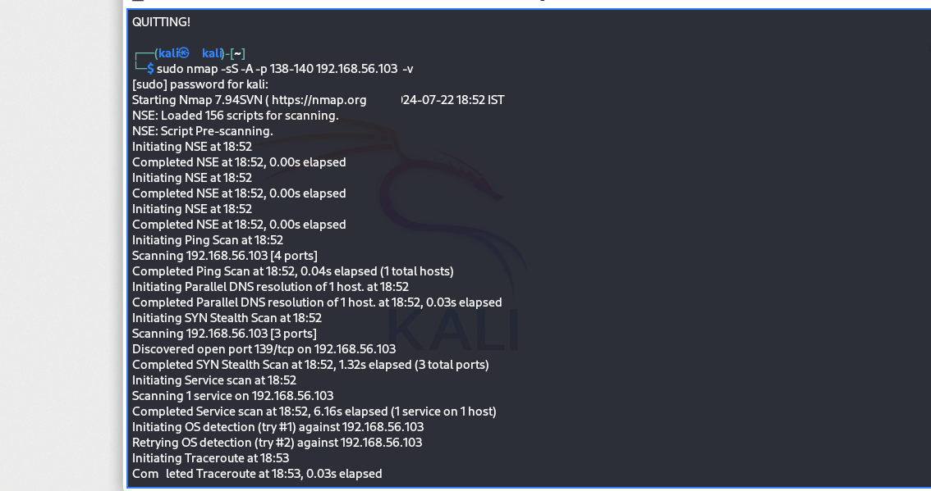
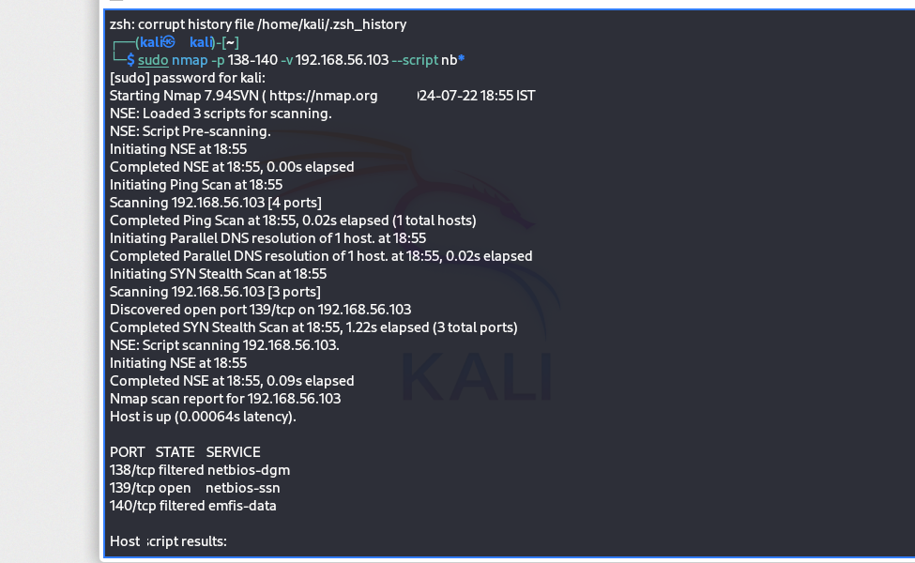
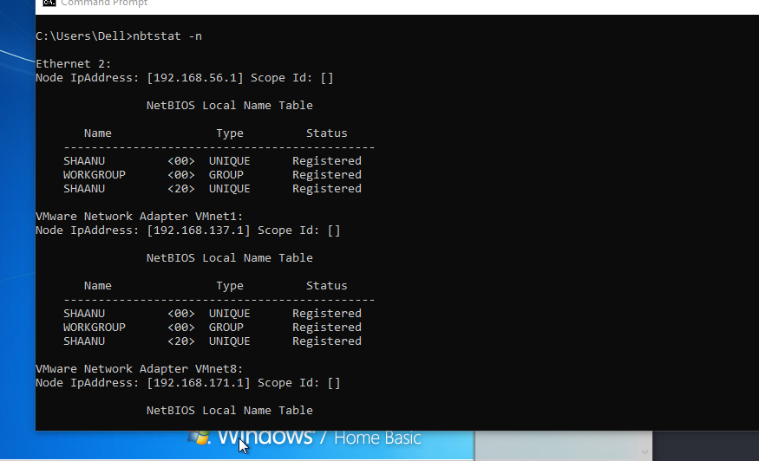
Understanding Some Service Enumeration types :-
1. NETBIOS Enumeration :
It stands for Network Basic Input and output system
It enables computer communication over a LAN and sharing of files and printers.
To enumerate the NetBIOS names, the remote system must have file and printer sharing enabled.
How to perform Netbios Enumeration:-
In windows : Open CMD
Use command nbtstat
In Linux terminal use command :
nmap –sS –A –p 138-140 target IP – V
nmap –p 138-140 –v target IP –script-nb*

Slide 20
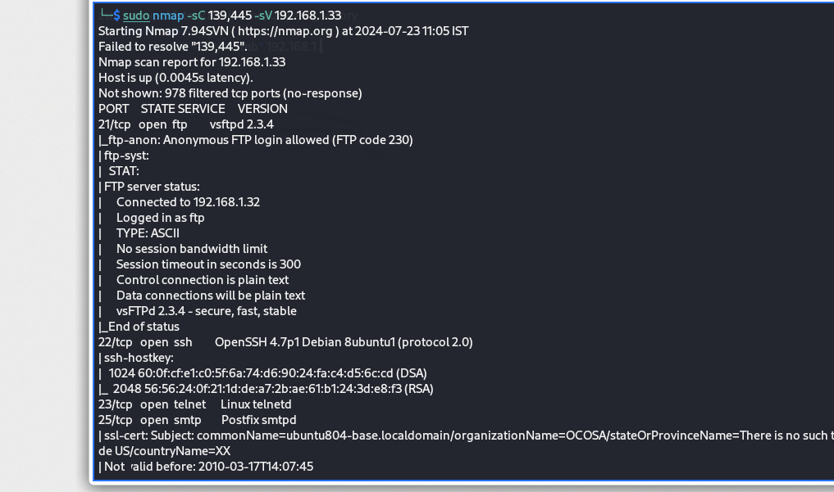
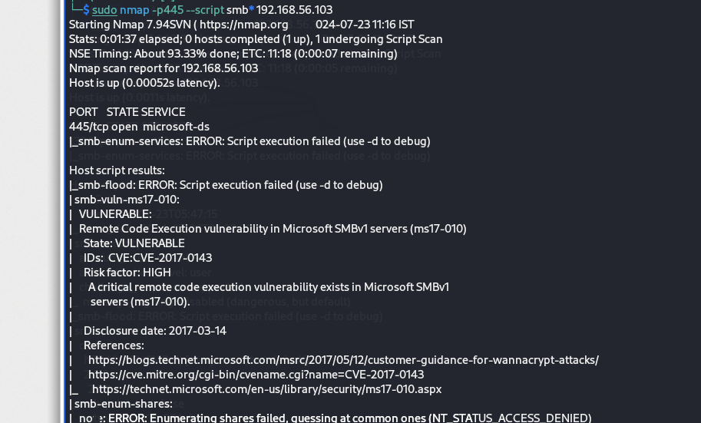
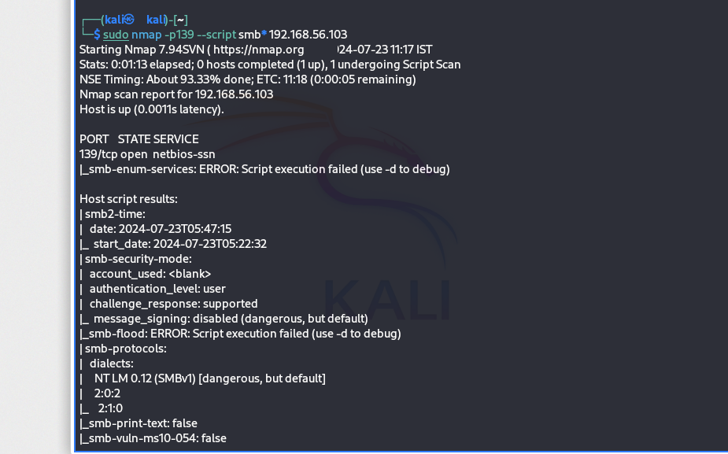
2. SMB Enumeration
It stands for Server Message Block.
It is a communication protocol used to share files, printers and miscellanous communication between nodes on a network.
How to perform SMB Enumeration :-
nmap – sC –p 139,445 –sV target IP
nmap – p139 --script smb* target IP
nmap –p 445 --script smb* target IP

Slide 21
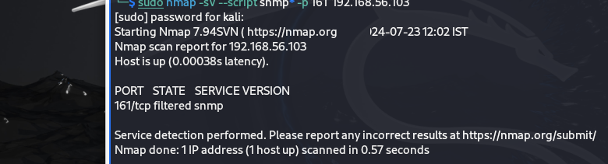
3. SNMP Enumeration :
It stands for Simple Network Management Protocol.
It is an Internet Standard Protocol for collecting and organizing information of network devices such as router ,cable modems, switches,etc.
It is used to monitor network ,detects network failure and sometime even to configure remote devices.
It is used by network Engineers.
How to perform SNMP Enumeration :-
nmap –sV –script snmp* -p 161 target ip

Slide 22
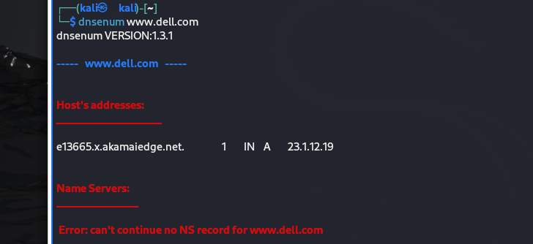
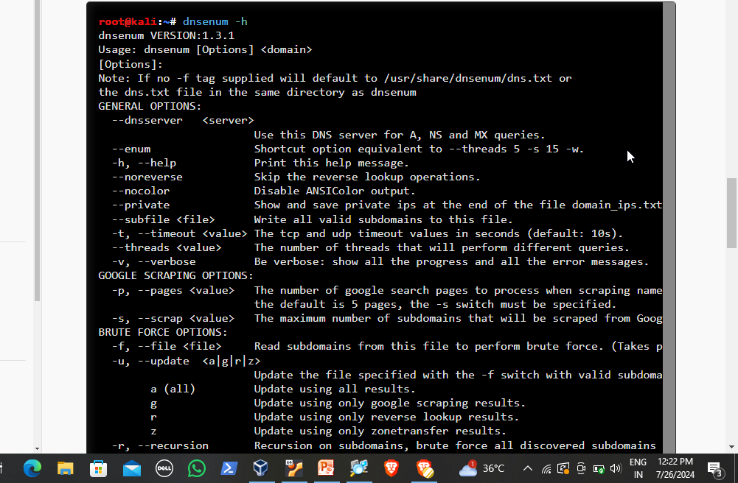
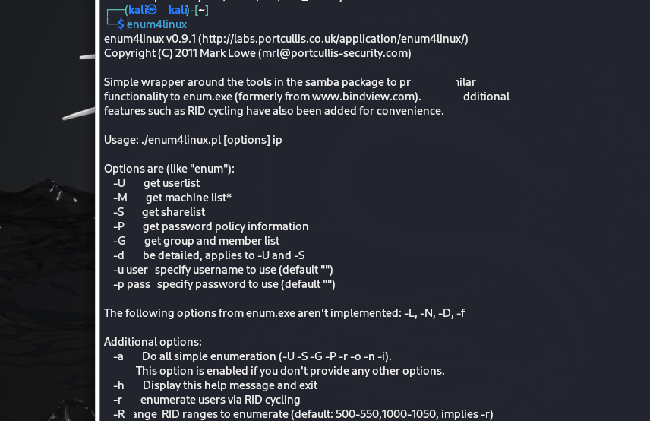
4. DNS Enumeration
Dnsenum is a multithreaded perl script to enumerate DNS information of a domain and to discover non-contiguous ip blocks. The main purpose of Dnsenum is to gather as much information as possible about a domain. The program currently performs the following operations:
Get the host’s addresses (A record).
Get the nameservers (threaded).
Get the MX record (threaded)
Get extra names and subdomains via google scraping (google query = “allinurl: -www site:domain”).
Brute force subdomains from file, can also perform recursion on subdomain that have NS records (all threaded).
Perform reverse lookups on netranges (C class or/and whois netranges) (threaded).
Write to domain_ips.txt file ip-blocks.
This program is useful for pentesters, ethical hackers and forensics experts. It also can be used for security tests.
How to perform dns enumeration :-
In linux terminal enter the command
dnsenum website name
On Nmap : nmap –sU –p53 –script dns-nec-enum website name
nmap –T4 –p53 –script dns-brute website name
Note: One of the tool for performing service
enumeration is Enum4linux
22

Slide 23
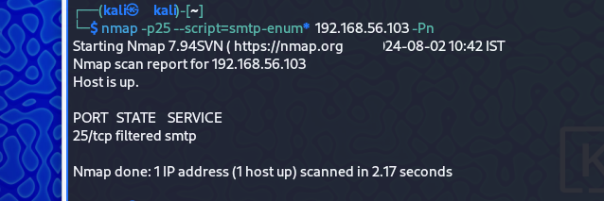
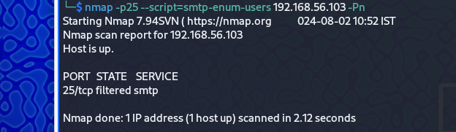
SMTP Enumeration
SMTP (Simple Mail Transfer Protocol) is a set of communication guidelines that allow web applications to perform communication tasks over the internet, including emails. It is a part of the TCP/IP protocol and works on moving emails across the network. SMTP enumeration allows us to identify valid users on the SMTP server.SMTP enumeration is a technique used to enumerate the SMTP service that is running on the target server.
How to perform SMTP Enumeration :-
nmap –p25 –script=smtp-enum* IP address
nmap –script=smtp-enum-users IP address

Slide 24
References
Google
Youtube
Chatgpt
Copilot

